Slide 1

Term Project Recommendation System of Contemporary Music
Team 009
Chun-Liang Kuo
Jian Feng Guo
Chien Hua Wang
Notes:
Recommendation system of contemporary music

Slide 2
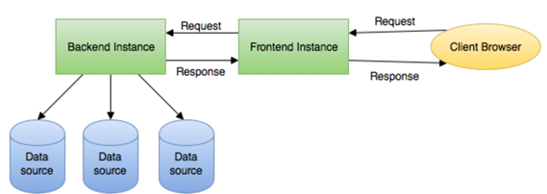
Overview
To help users more efficiently find out their favorite from tons of songs, we implemented a music recommendation system by MapReduce, collaborative filtering and distributed cloud computing.
Million Song Data Dataset contains millions of albums information. Our main achievement is building a simple web service architecture shown as following:

Slide 3
Literature Survey
Content-based Approach
Based on metadata of item and uses different methods to compute distance. The purpose is to find the most similar K items from corresponding metadata.
Pros: easy to implement, only consider the metadata of items
Cons: time consuming while the amount of item is large
Notes:
which is called k nearest neighbor(KNN).

Slide 4
Literature Survey
Collaborative Filtering Approach
Focus on transaction and interaction between users and item.
Use a User/Item matrix to represent the interaction data of users and items as below.
 | Item1 | Item2 | Item3 | Item4
User1
User2
User3
User4
Notes:
collaborative filtering approach takes more care about the transaction and interaction between users and items, and analyze these data to recommend proper items to users. We can use a matrix to represent the interaction data of users and items

Slide 5
Literature Survey
Principle component Analysis (PCA)
A process of recognizing a smaller amount of uncorrelated variables.
The purpose is to clarify the maximum amount of variance with the fewest amount of principal components.
Can be applied in analysis to reduce the number of variables and avoid multi-collinearity.

Slide 6
Literature Survey
Apache Spark
Spark allows users to store data into cluster memory and repeat the calculation frequently
Compare to Hadoop MapReduce:
Hadoop needs to store the medium data into hard disk.
Spark store the medium data in memory and has concept of distributed memory abstraction which reduce disk writes and increase ­memory data processing.
Notes:
Hadoop needs to store the medium data into hard disk which is a bottleneck of efficiency.

Slide 7
Technique
Cleaning and formatting data source
Use MapReduce to deal with JSON string
{“genreid”: TRVMOOV128F92E4D89,”author”:”SFX - Cars Specific; Lamborghini”, “styles”:[game, rock, …], followers: [xxx1,xxx2,xxx3]}
TRVMOOV128F92E4D89 SFX - Cars Specific; Lamborghini game#rock#... xxx1#xxx2#xxx3…
Building recommendation system:
Partition dataset and set a random integer generator to generate random offset of partition file.
Divide the dataset into three parts:
Train Set (40%), Cross Validation Set (20%), Test Set (40%)

Slide 8
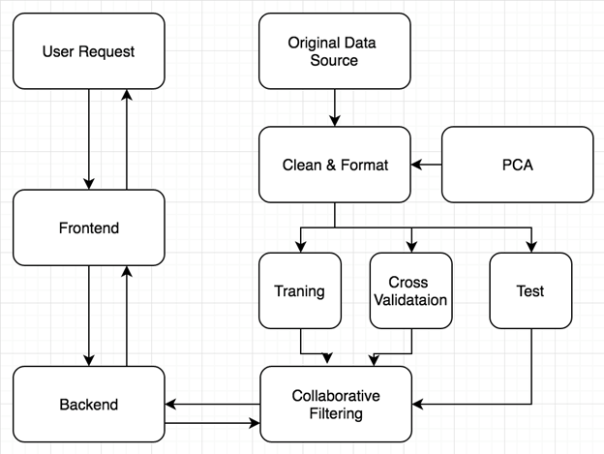
Technique
System Structure

Slide 9
Analysis Result
List the top albums to verify with our results
The chart below are top 8 game albums.
There is an overlapping item TRTPFNO128F92FF4C5 which is the first recommended item of our two testing.
GENREID(VARCHAR) | ARTISTID(VARCHAR) | PREFERENCE(INTEGER)
TRTWBKF12903CD96B6 | SR9JSH21187FB4C028 | 783868
GRAWTGT128F146ECF1 | SLT50HO1187FB4D0ED | 743123
UHZSMPB128F4291BDB | FVSZWK21187B9B26D7 | 732603
JQIQRUU128F931F86F TRTPFNO128F92FF4C5 | KMTJECM1187B9930BA ARGHPIE1187FB3CCDF | 730276 685404
CNATROO128F42544AB | QRZHZ8X1187B9A5C1B | 632101
TRLBEHJ128F428F46D | ARGI5FG1187B9A1A70 | 615384
BEUHIYM128F424D618 | RMI18NF1187B99FC57 | 592029

Slide 10
Conclusion
Use Spark framework and Scala to implement user-based collaborative filtering algorithm.
The recommendation system can process large amount of data in relatively short time by making use of distributed memory abstraction layer of Apache Spark for recommendation system.
This project could be further developed by including more music features for recommendation process.
Different query dependent features can be implemented to help recommendation system to be more precise and accurate.
Notes:
process training until convergence of recommended results

